Slide 1
Quantum Computing Architectures (EE274) Lecture 13
Hiu-Yung Wong
Mar. 6, 2025
hiuyung.wong@sjsu.edu, Office: ENG363
http://www.sjsu.edu/people/hiuyung.wong/index.html

Slide 2
Outline
Spin Rabi Oscillation with Linear Magnetic Field
Spin: Rabi Oscillation with Rotating Magnetic Field
HW 2 Due this weekend; no late submissions
Midterm Next Week: Cover all materials up to this week. 1 letter-size cheat sheet (double-sided).

Slide 3
Rabi Oscillations
Chapter 9 of “Quantum Computing Architecture and Hardware for Engineers: Step by Step”
This part has a lot of maths. You only need to be able to understand and derive them open-book (e.g. for assignment). But you need to understand what I am doing.

Slide 4
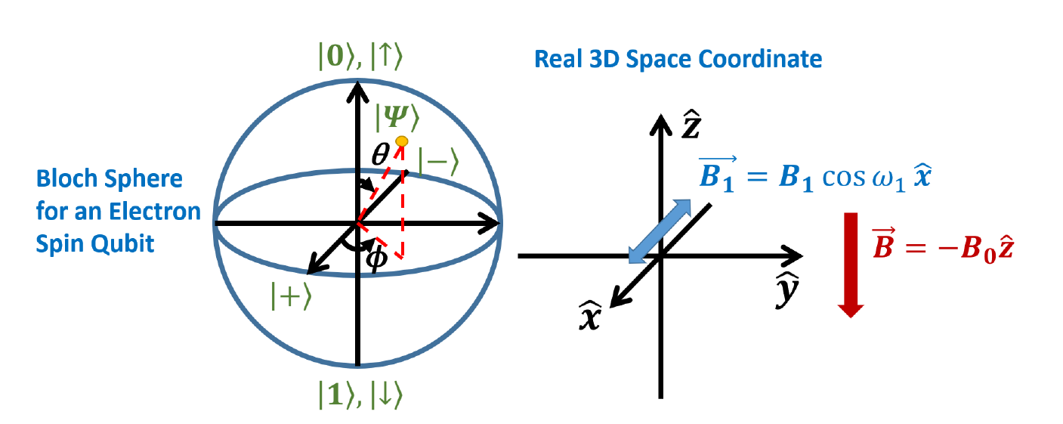
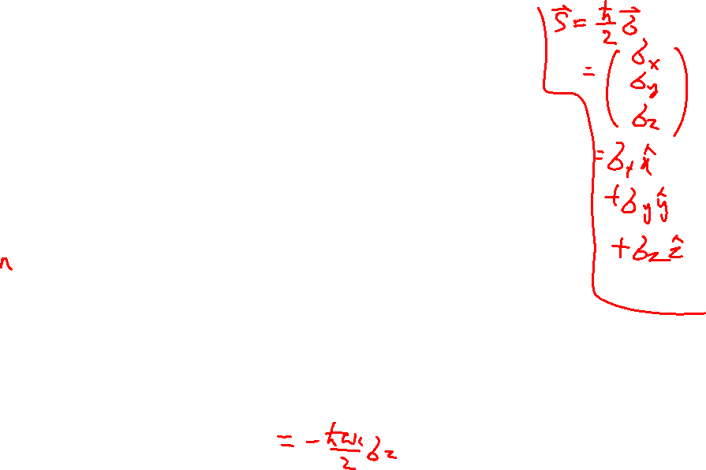
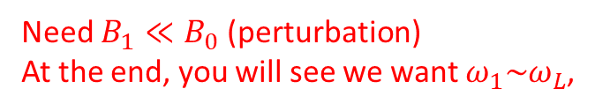
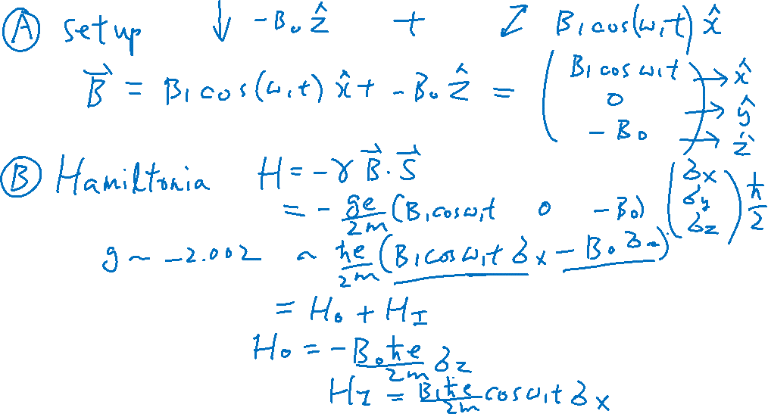
Rabi Oscillation – Experiment Setup
From the Last Lecture
Learning outcomes: Setup
Need $B_{1}≪B_{0}$ (perturbation)
At the end, you will see we want $ω_{1}\sim ω_{L}$,

Slide 5
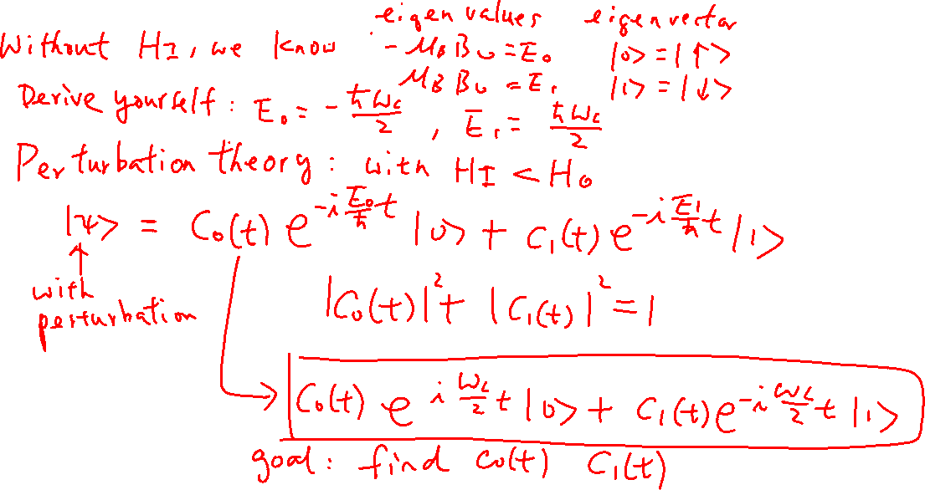
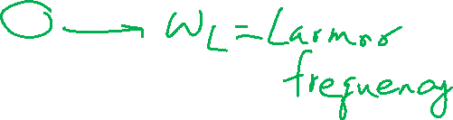
Rabi Oscillation
From the Last Lecture
Learning outcomes: Skill in solving system of differential equations

Slide 6
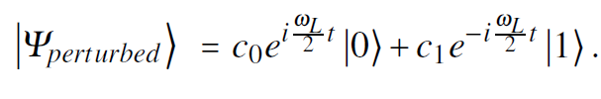
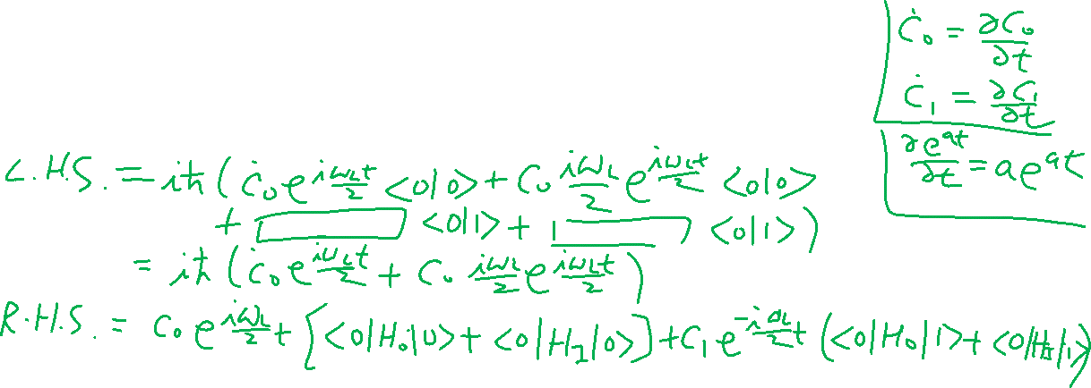
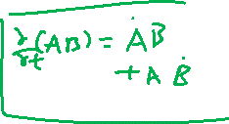
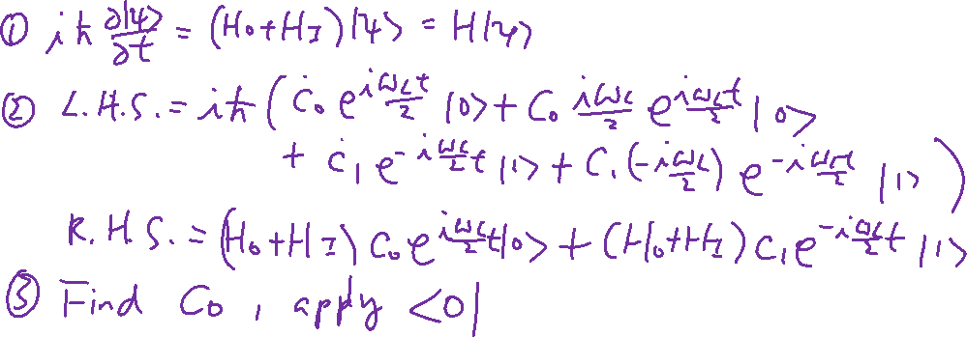
Rabi Oscillation – Solve S.E.
From the Last Lecture
Learning outcomes: Skill in solving system of differential equations

Slide 7
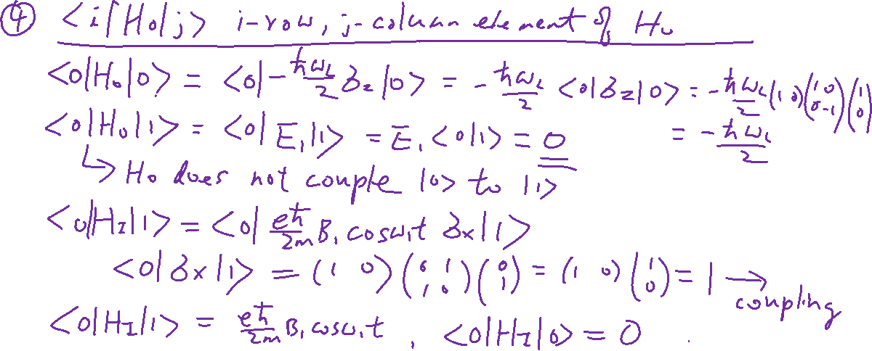
Rabi Oscillation – Solve S.E.
From the Last Lecture
Learning outcomes: Skill in solving system of differential equations

Slide 8
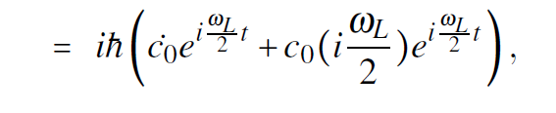
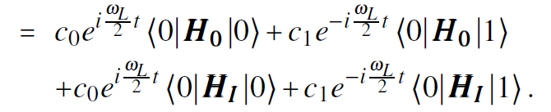
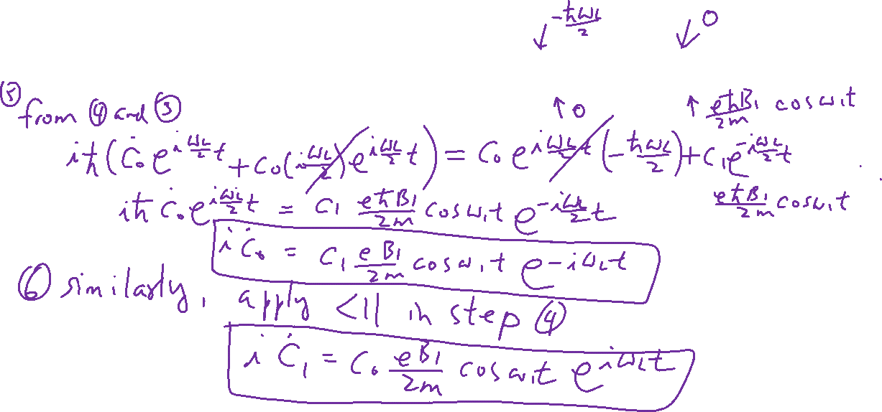
Rabi Oscillation – Solve S.E.
From the Last Lecture
Learning outcomes: Skill in solving system of differential equations
R.H.S
L.H.S

Slide 9



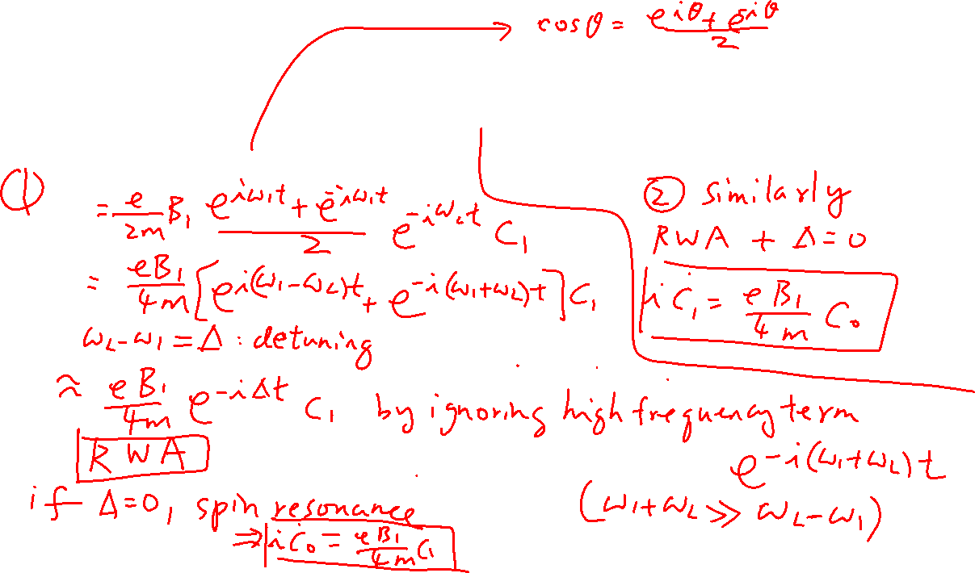
Rotating Wave Approximation (RWA) and Spin Resonance
From the Last Lecture
Learning outcomes: Rotating Wave Approximation

Slide 10
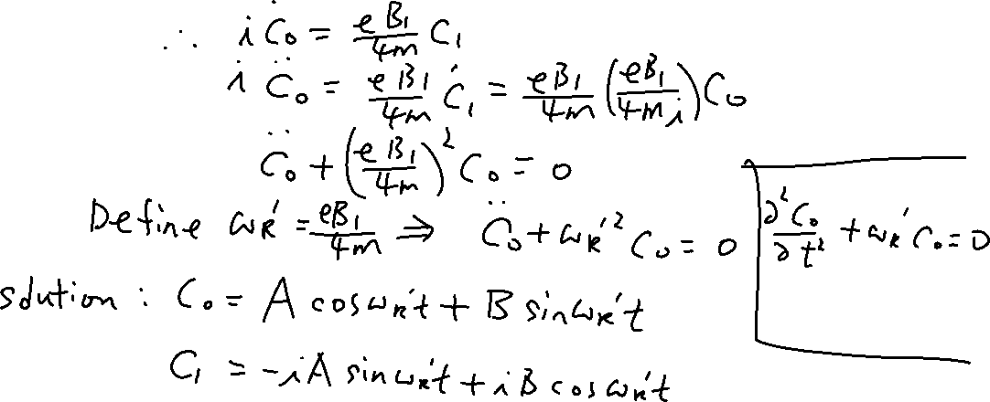

Solution
From the Last Lecture

Slide 11

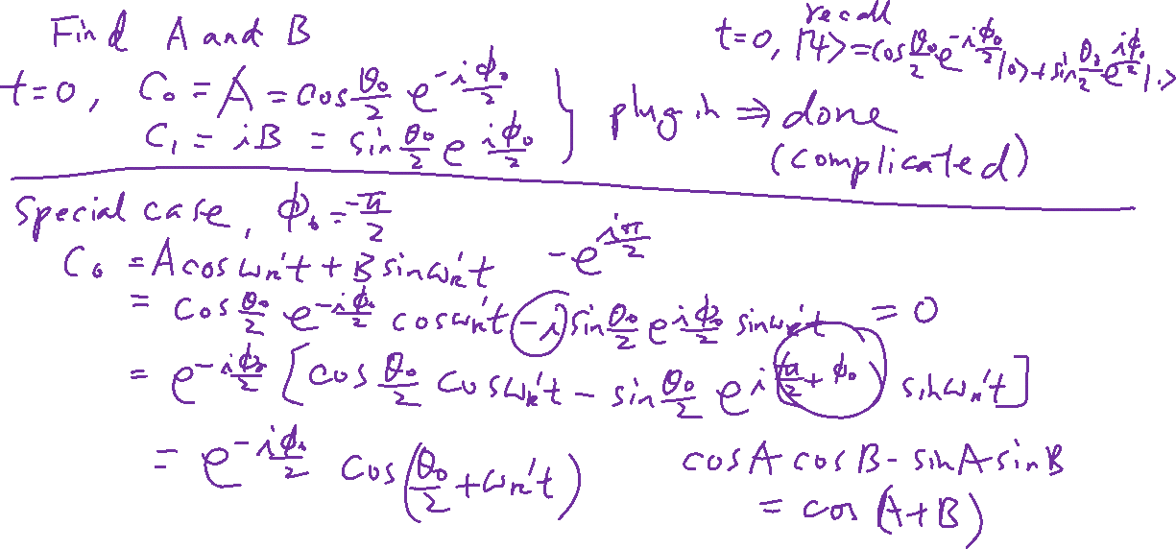
Rabi Oscillation
From the Last Lecture

Slide 12
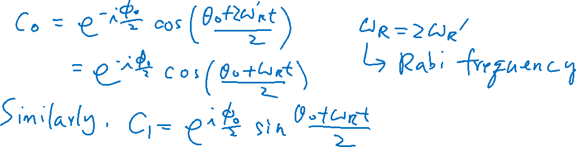
Rabi Oscillation

Slide 13
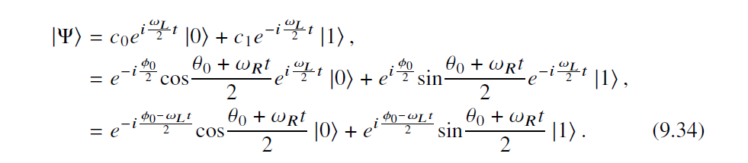
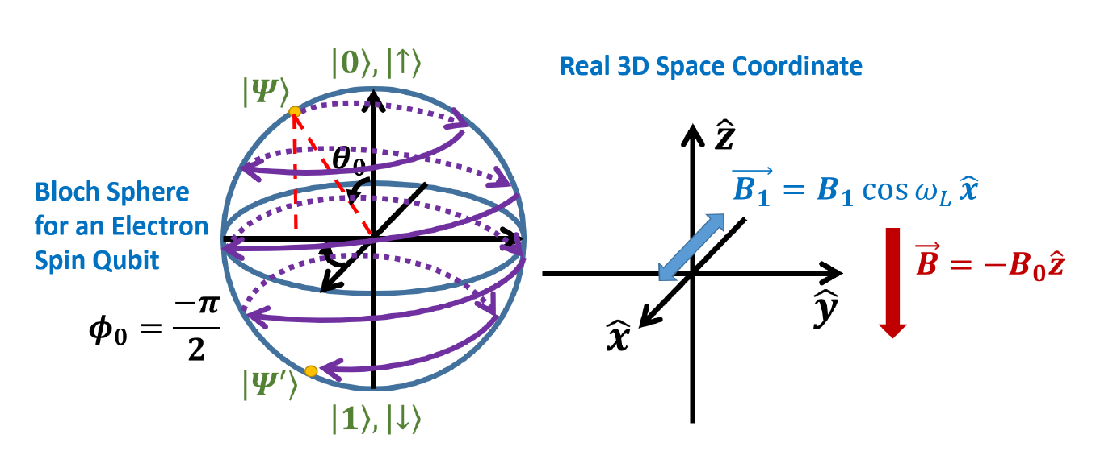
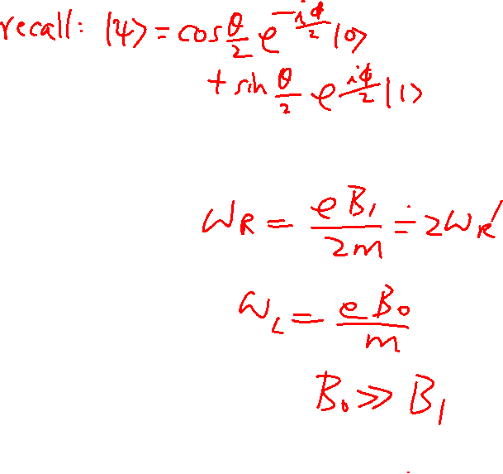
Rabi Oscillation

Slide 14
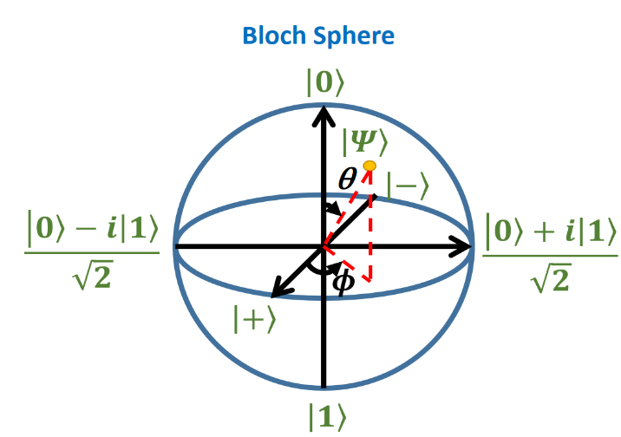
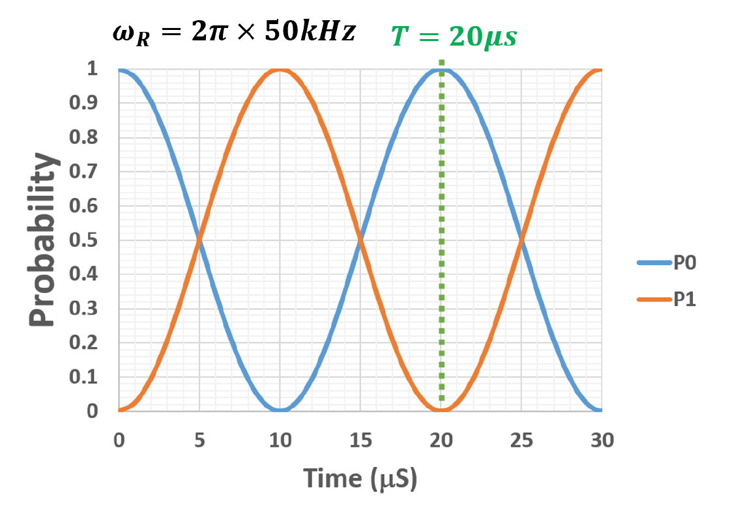
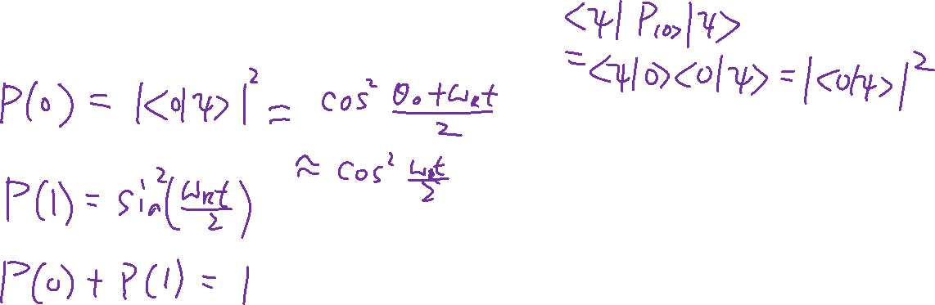
Rabi Oscillation – Final Effect

Slide 15
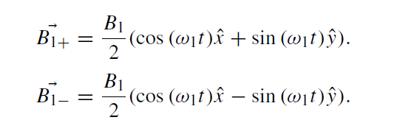
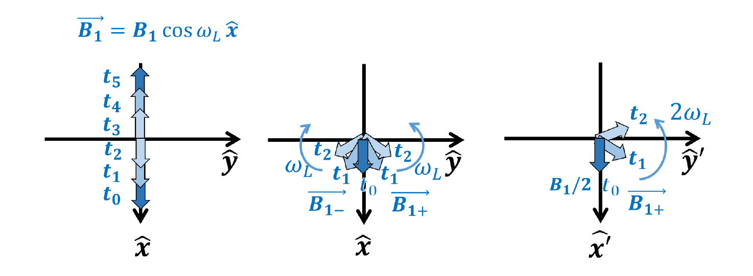

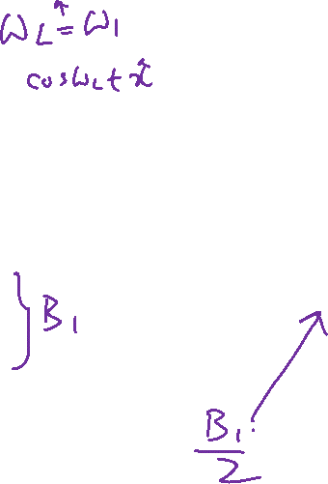
Spin Resonance, Rotating Frame, RWA
Learning outcomes: Understand RWA approach in an intuitive way and its relationship to spin resonance, rotating frame
Rabi oscillation is just Larmor Precession in the rotating frame

Slide 16
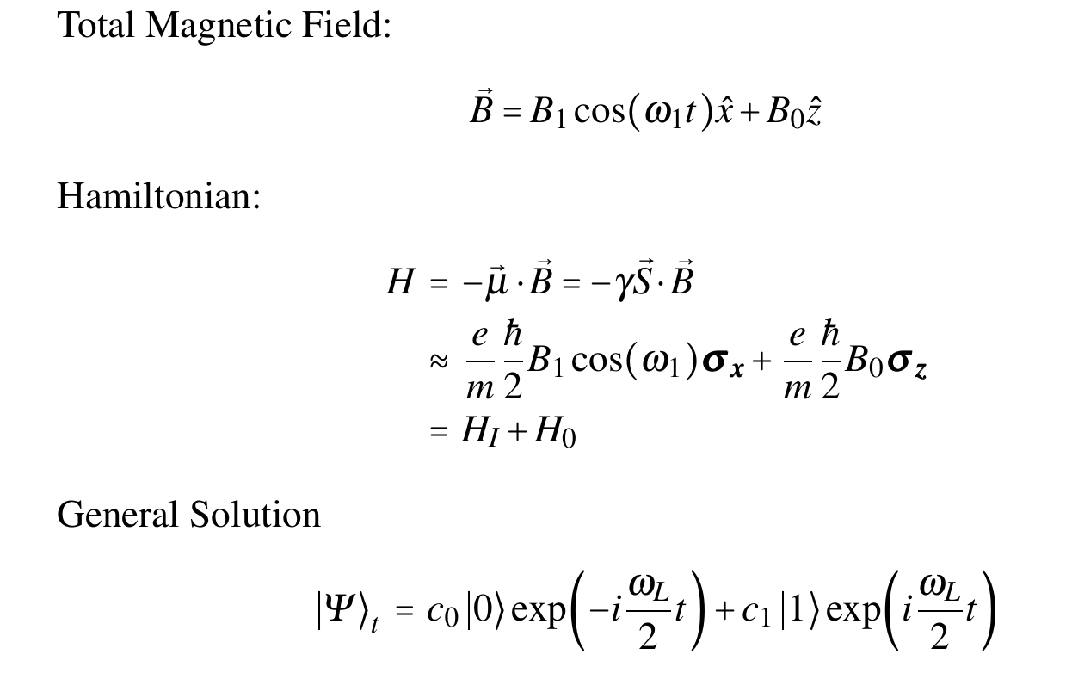

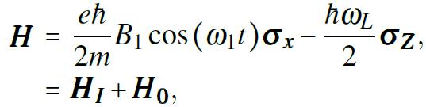
Summary

Slide 17
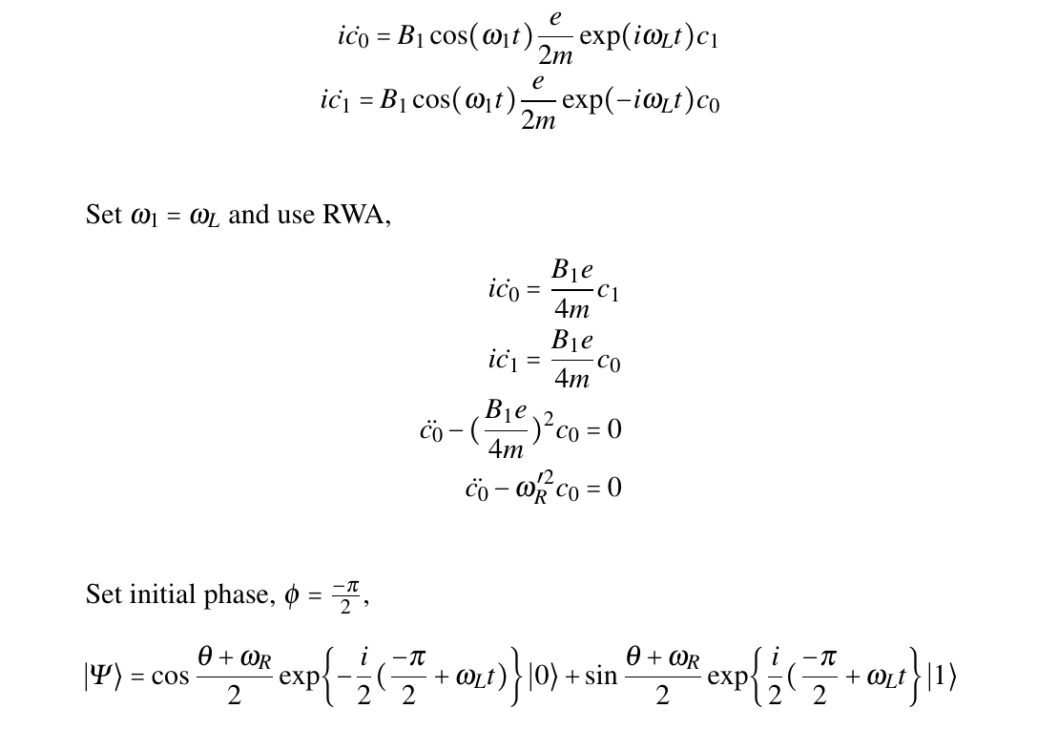
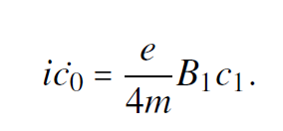
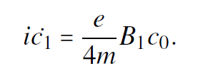


Slide 18
Rabi Oscillation under a rotating magnetic field
Chapter 10 of “Quantum Computing Architecture and Hardware for Engineers: Step by Step”
This part has a lot of maths. You only need to be able to understand and derive them open-book (e.g. for assignment). But you need to understand what I am doing.

Slide 19
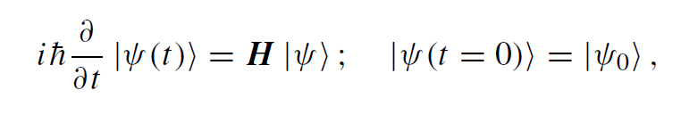
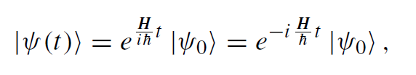
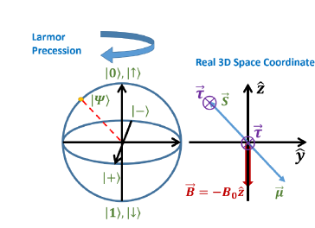
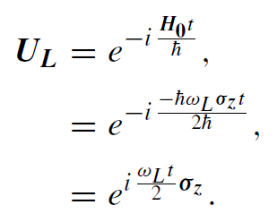
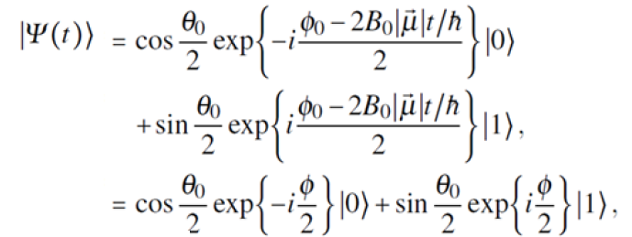
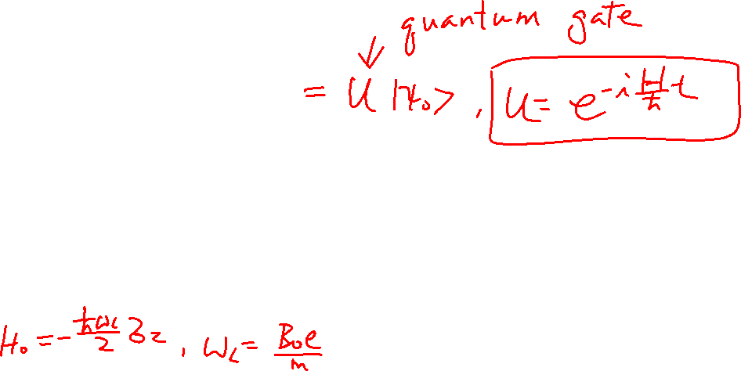
Quantum Gate and Hamiltonian
General Solution to S.E.
Example: for Larmor Precession:
Recall:

Slide 20

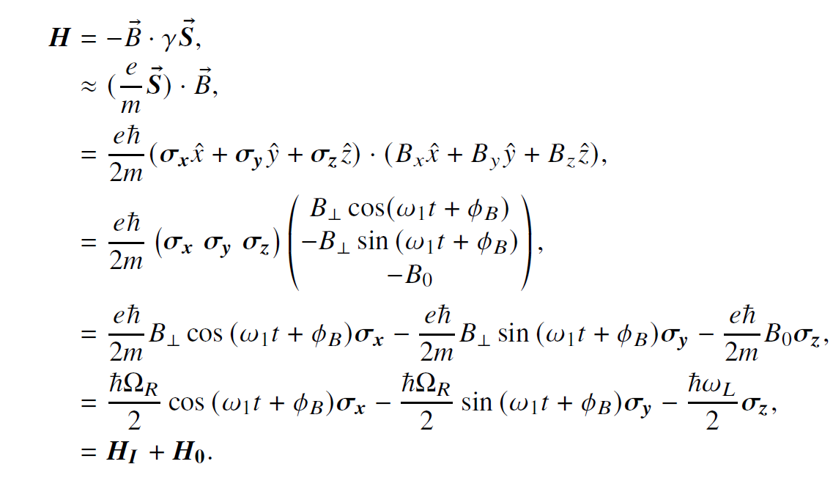
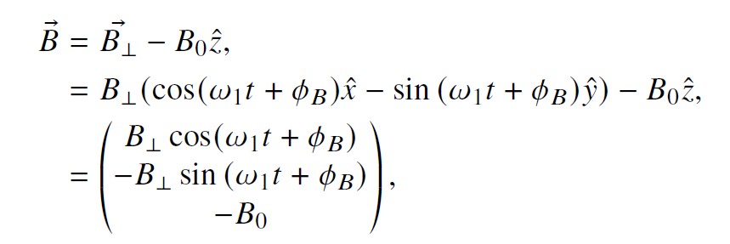
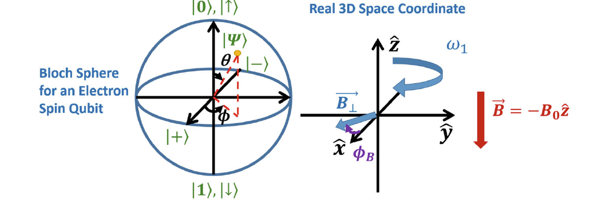

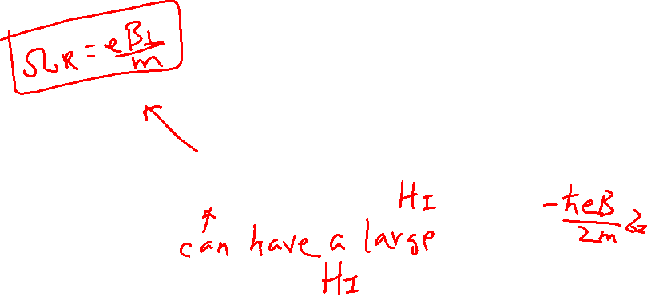
Rabi Oscillation with Rotating Magnetic Field
Learning outcomes: Able to write the Hamiltonian

Slide 21
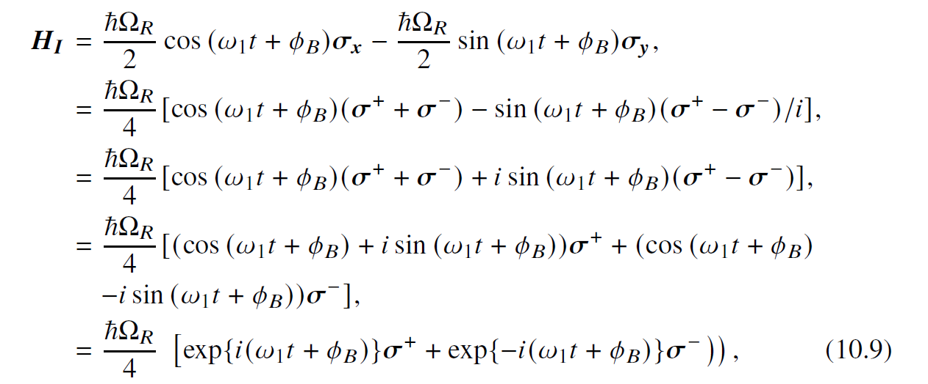
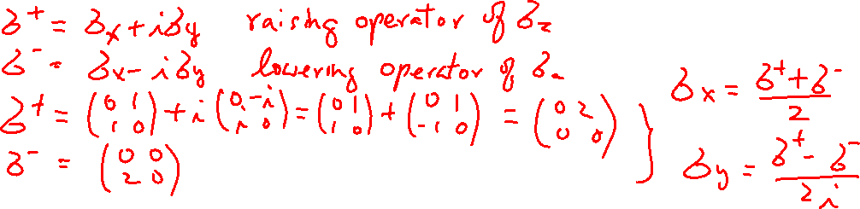
Rabi Oscillation with Rotating Magnetic Field Raising and Lowering Operators
Learning outcomes: Able to write the Hamiltonian

Slide 22
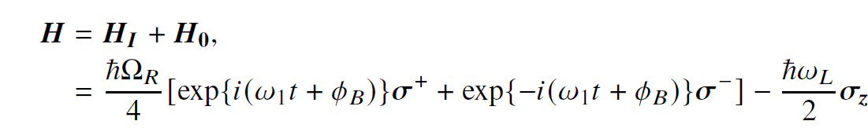
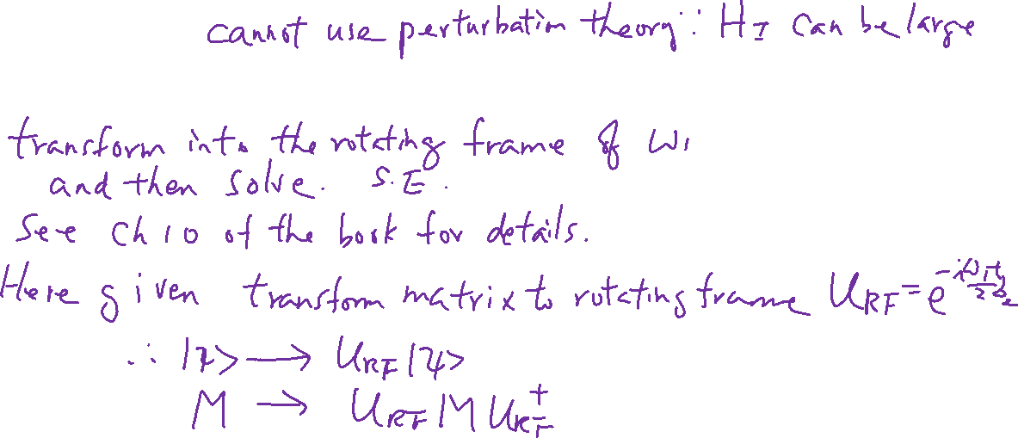
Rotating Frame (no RWA)
Learning outcomes: Know how to do transformation

Slide 23
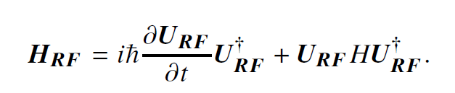
Rotating Frame (no RWA) Express Hamiltonian in the Rotating Frame
Learning outcomes: Know how to do transformation

